Slide 1

Introduction to K8S and AKS
Ala’ Yasin Abuhijleh

Slide 2
Agenda
Introduction
K8S Cluster Components
Pods
Service discovery
Deployment
Package Management with Helm
Ingress and HTTP load balancing
More Resources types
Role Based Access
Azure Kubernetes Service (AKS)
Notes:
Start Leadership positions

Slide 3

Introduction
Challenges in managing containerized applications
What is Kubernetes
What is Declarative Configuration
What is Immutable Infrastructure
Kubernetes cluster components
Deploy a Kubernetes Cluster

Slide 4
Containerized applications challenges
Containers/services discovery
Persistent Storage
Scalability
Rollout and rollback
Resource management
Handling failed containers
More….
Notes:
As the number of containers grows, it becomes very hard to manage them. Some of the challenges we face in containerized applications
Containers have become popular because they provide extra benefits, such as:
Agile application creation and deployment: increased ease and efficiency of container image creation compared to VM image use.
Continuous development, integration, and deployment: provides for reliable and frequent container image build and deployment with quick and easy rollbacks (due to image immutability).
Dev and Ops separation of concerns: create application container images at build/release time rather than deployment time, thereby decoupling applications from infrastructure.
Observability not only surfaces OS-level information and metrics, but also application health and other signals.
Environmental consistency across development, testing, and production: Runs the same on a laptop as it does in the cloud.
Cloud and OS distribution portability: Runs on Ubuntu, RHEL, CoreOS, on-premises, on major public clouds, and anywhere else.
Application-centric management: Raises the level of abstraction from running an OS on virtual hardware to running an application on an OS using logical resources.
Loosely coupled, distributed, elastic, liberated micro-services: applications are broken into smaller, independent pieces and can be deployed and managed dynamically – not a monolithic stack running on one big single-purpose machine.
Resource isolation: predictable application performance.
Resource utilization: high efficiency and density.

Slide 5
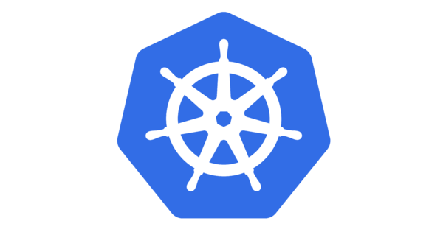
What is Kubernetes (K8S)
is an open-source system for automating deployment, scaling, and management of containerized applications
It groups containers that make up an application into logical units for easy management and discovery.
Production-Grade Container Orchestration
Notes:
Kubernetes builds upon 15 years of experience of running production workloads at Google, combined with best-of-breed ideas and practices from the community.
Maybe that’s why the funny advertisements! Maybe they want some one from inside google!!

Slide 6

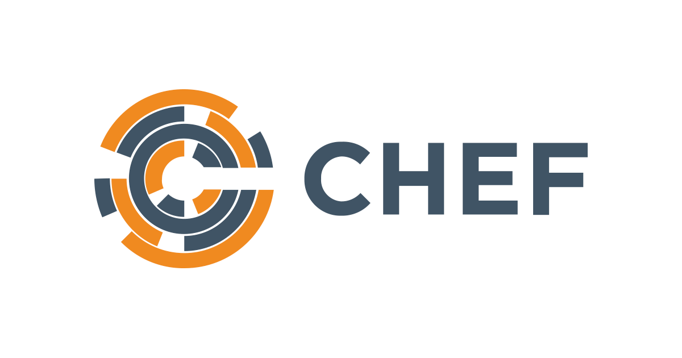
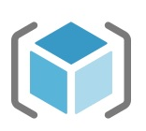
What is Declarative Configuration
Declaring the desired state of some system (be it a physical machine, an EC2 VPC, an entire Google Cloud account, or anything else), and then allow the system to automatically compare that desired state to the present state, and then automatically update the managed system to match the declared state.
Notes:
Kubernetes builds upon 15 years of experience of running production workloads at Google, combined with best-of-breed ideas and practices from the community.
Maybe that’s why the funny advertisements! Maybe they want some one from inside google!!

Slide 7


What is Immutable Infrastructure
An infrastructure paradigm in which infrastructure components are never modified
after they’re deployed. If something needs to be updated, fixed, or modified in any way,
new built from a common image/script with the appropriate changes are provisioned to replace the old
ones. After they’re validated, they’re put into use and the old ones are decommissioned.
Pets VS Cattles!
Notes:
Kubernetes builds upon 15 years of experience of running production workloads at Google, combined with best-of-breed ideas and practices from the community.
Maybe that’s why the funny advertisements! Maybe they want some one from inside google!!

Slide 8
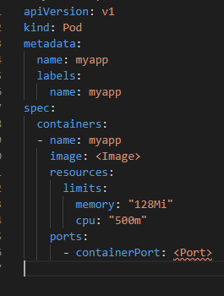
Linking the dots
K8S use manifest to declare the cluster components (YAML)
K8S supports the immutable infrastructure paradigm
Notes:
Kubernetes builds upon 15 years of experience of running production workloads at Google, combined with best-of-breed ideas and practices from the community.
Maybe that’s why the funny advertisements! Maybe they want some one from inside google!!

Slide 9
K8S Cluster components
Components Brief
Deploy K8s cluster
Namespaces and contexts
Labels
Common commands
Demo

Slide 10
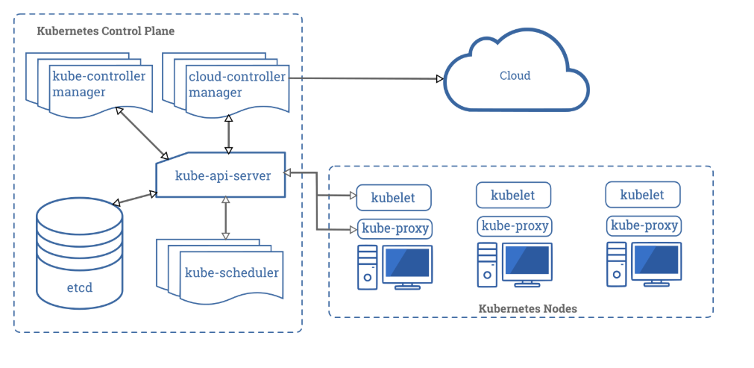
K8s cluster components
Embeds cloud-specific control logic. The cloud controller manager lets you link your cluster into your cloud provider's API
Runs controller processes: node controller, replication controller, Endpoint controller, Service Account & Token controllers
The control plane manages the worker nodes and the Pods in the cluster. This node is usually called the master node
A Kubernetes cluster consists of a set of worker machines, called nodes,. The worker node(s) host the Pods that are the components of the application workload.
The API server is a component of the Kubernetes control plane that exposes the Kubernetes API. The API server is the front end for the Kubernetes control plane
An agent that runs on each node in the cluster. It makes sure that containers are running in a Pod.
kube-proxy is a network proxy that runs on each node in your cluster, implementing part of the Kubernetes Service concept.
Consistent and highly-available key value store used as Kubernetes' backing store for all cluster data.
Watches for newly created Pods with no assigned node, and selects a node for them to run on.
Notes:
Kubernetes builds upon 15 years of experience of running production workloads at Google, combined with best-of-breed ideas and practices from the community.
Maybe that’s why the funny advertisements! Maybe they want some one from inside google!! In production environments, the control plane usually runs across multiple computers and a cluster usually runs multiple nodes, providing fault-tolerance and high availability
Kubelets: The kubelet takes a set of PodSpecs that are provided through various mechanisms and ensures that the containers described in those PodSpecs are running and healthy. The kubelet doesn’t manage containers which were not created by Kubernetes
kube-proxy maintains network rules on nodes. These network rules allow network communication to your Pods from network sessions inside or outside of your cluster.
kube-controller-manager
Control Plane component that runs controller processes.
Logically, each controller is a separate process, but to reduce complexity, they are all compiled into a single binary and run in a single process.
These controllers include:
Node controller: Responsible for noticing and responding when nodes go down.
Replication controller: Responsible for maintaining the correct number of pods for every replication controller object in the system.
Endpoints controller: Populates the Endpoints object (that is, joins Services & Pods).
Service Account & Token controllers: Create default accounts and API access tokens for new namespaces.

Slide 11
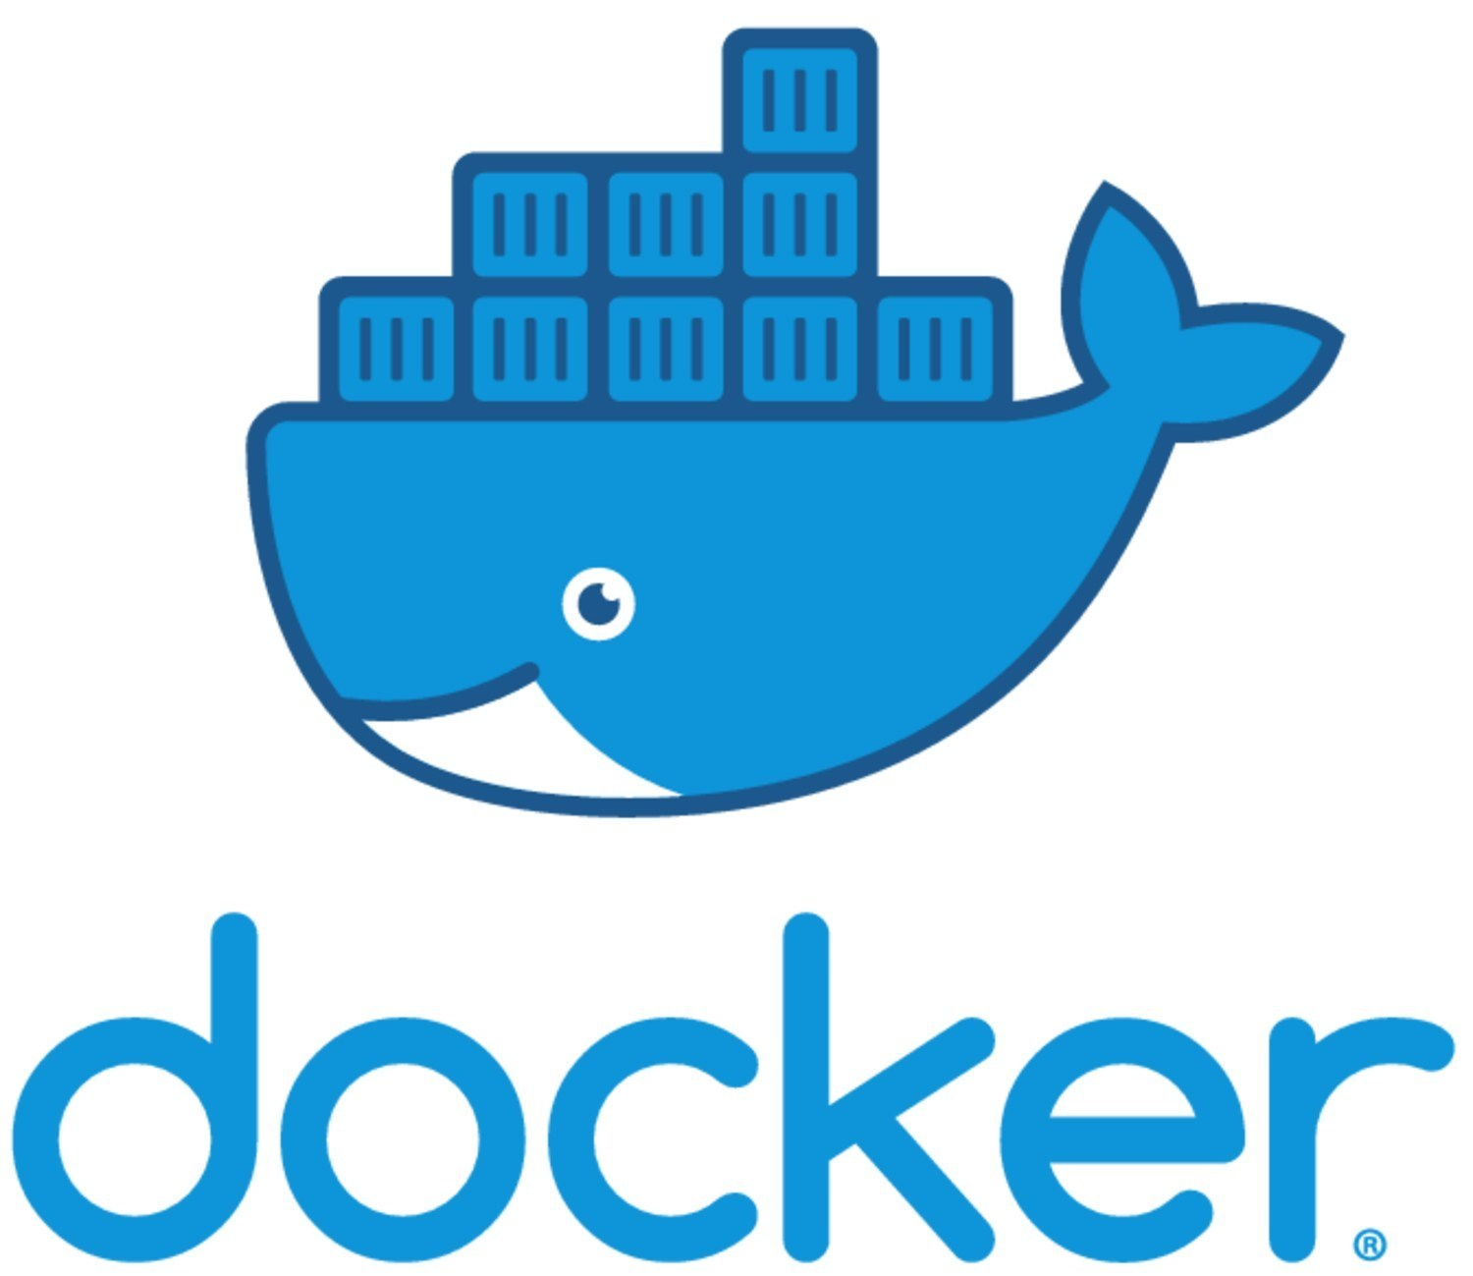
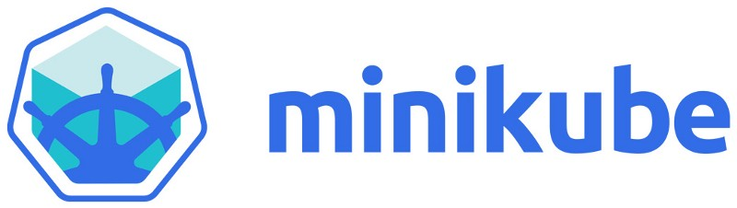
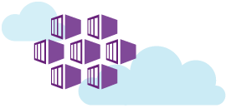
Deploy k8s cluster
Azure Kubernetes Services

Slide 12
K8s namespaces and contexts
Namespaces are used to organize objects in the cluster.
You can think of each namespace as a folder that holds a set of objects.
By default, the kubectl command line tool interacts with the default namespace.
If you want to use a different namespace you have to indicate this either by passing the namespace flag in the command line or switch the “Context”
Context is a composite of Cluster, Namespace and User

Slide 13
Labels
Provide identifying metadata for objects.
Are fundamental qualities of the object that will be used for grouping, viewing, and operating.

Slide 14
Common commands
Everything is represented by a RESTful resource (object)
Each object exists at a unique HTTP path that lead to the representation of the object https://your-k8s.com/api/v1/name‐spaces/default/pods/my-pod
The kubectl command makes HTTP requests to these URLs to access the Kubernetes objects
Common commands:
Kubectl get <resource-name> <object-name>
kubectl describe <resource-name> <obj-name>
kubectl delete <resource-name> <obj-name>
kubectl edit <resource-name> <obj-name>
kubectl apply -f <manifest-file>
Notes:
Everything contained in Kubernetes is represented by a RESTful resource
Each Kubernetes object exists at a unique HTTP path; for example, https://your-k8s.com/api/v1/name‐
spaces/default/pods/my-pod leads to the representation of a Pod in the default name‐

Slide 15
Demo
Run Kubernetes cluster on Docker desktop
Kubectl Command Line
List nodes in the cluster
Explore namespaces
Explore contexts
Notes:
Enable Kubernetes
Go to Code and run:
Kubectl get nodes
List namespaces
Create namespace
View context: kubectl config get-context
Create context: kubectl config set-context
kubectl config set-context k8s-demo --cluster docker-desktop --user docker-desktop

Slide 16
Pods
What are pods?
Pod Manifest
Demo

Slide 17
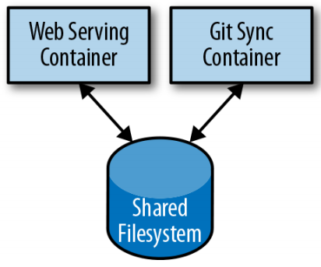
Pods
The basic execution unit of a Kubernetes application
The smallest and simplest unit in the Kubernetes object model that you create or deploy
Represents processes running on your cluster
It encapsulate:
application's container (or, in some cases, multiple containers),
storage resources
a unique network identity (IP address)
Options to govern how the container(s) should run

Slide 18
Persistent Volumes
When a Pod is deleted or a container restarts, any and all data in the container’s file system is also deleted.
In many occasion, having access to persistent disk storage is an important part of a healthy application.
To add a volume to a Pod manifest, there is 2 parts:
Defining all the volumes that may be accessed by containers in the Pod manifest using spec.volumues.
Availing the volumes to containers using volumeMounts array in the container definition
Notes:
There are many other types of volumes supported

Slide 19
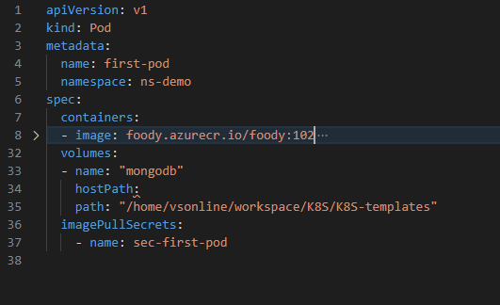
Pod Manifest
Version and Object kind
Metadata
Specifications of the Containers
Secret to pull image from a private registry

Slide 20
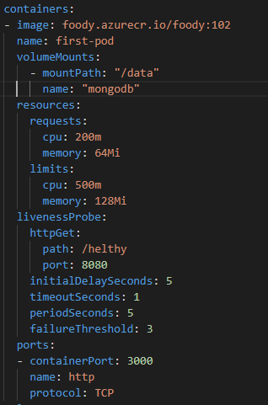
Pods Manifest Containers
Image details
Volumes
Requested resources
Health check
Ports

Slide 21
Demo
Running the first pod
Notes:
Apply
View status (-w)
Use Describe
View logs

Slide 22
Services
Services discovery
Exposing pods
Demo

Slide 23
Service discovery
Kubernetes is a very dynamic system
Number of pods might change
Location of pods might change
However, finding pods could be a problem. Most of the traditional network infrastructure wasn’t built for the level of dynamism.
Service object is the main component for service discovery
Kubernetes uses its own DNS for service discovery
First-service.first-demo.svc.cluster.local
Service name
namespace
Cluster name

Slide 24
Exposing Pods
ClusterIP: Service only accessible from inside the cluster using the provided ClusterIP.
NodePort: Service can be accessed using the nodes IPs directly.
LoadBalancer: Service can be accessed from outside the cluster using a public IP address
ExternalName: a proxy for external service

Slide 25
Demo
Expose pods
Service Manifest
Access the service locally
Notes:
kubectl expose pod first-pod -n ns-demo --port 8080 --target-port 3000
Kubectl edit svc first-pod –n ns-demo
kubectl apply -f .\service-demo.yml

Slide 26
Deployments
What is a deployment?
Deployment manifest
recreate strategy and rolling update strategy
scaling up and down

Slide 27
What is a deployment?
Enables you to simply and reliably roll out new software versions without downtime or errors.
Represents deployed applications in a way that transcends any particular version.
Enables you to easily move from one version of your code to the next.
Provides a “rollout” process is specifiable and careful
It waits for a user configurable amount of time between upgrading individual Pods.
It also uses health checks to ensure that the new version of the application is operating correctly
Totally automated (deployment controller)
Notes:
Mention the replica sets and how it was working…

Slide 28
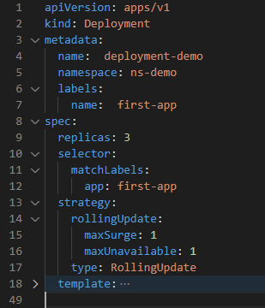
Deployment Manifest
Desired number of pods
Target pods
Strategy details
Pods definition

Slide 29
Strategies
Rolling Update
MaxSurge: The maximum number of pods exceeding the number indicated in the replicas attribute
MaxUnavailable: The maximum number of pods not available at a certain time
Recreate
Kill all pods before new ones are created
Notes:
there are situations where you don’t want to fall below 100% capacity

Slide 30
Autoscaling
Kubernetes can handle all of these scenarios via Horizontal Pod Autoscaling resource kubectl autoscale deployment deployment-demo --cpu-percent=50 --min=1 --max=10
Autoscaling in Kuebernetes can be done on CPU or custom metrics
HPA requires the presence of the heapster Pod on your cluster.
Notes:
there are situations where you don’t want to fall below 100% capacity

Slide 31
Demo
Create first deployment
Auto scale deployment
View auto scale manifest
View deployment history
Notes:
kubectl apply –f deployment-demo.yml
kubectl autoscale deployment deployment-demo --cpu-percent=50 --min=1 --max=10
Kubectl edit hpa
kubectl rollout history deployment deployment-demo

Slide 32
Helm and ingress
What is helm
Ingress
Ingress manifest
demo

Slide 33
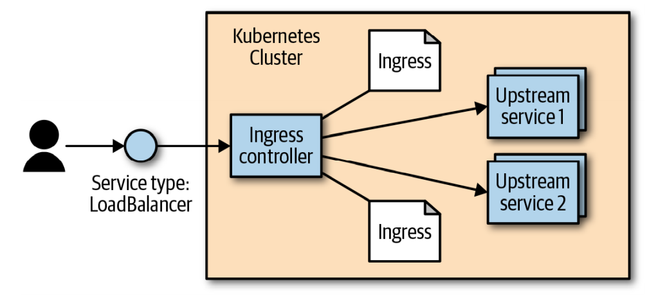
Ingress
HTTP-based load-balancing system in K8S is called Ingress
Ingress specs are separated from the ingress controller
K8S has no “standard” Ingress controller you can install one of many optional implementations.
A service of type “LoadBalancer” will be automatically created with the Ingress Controller

Slide 34
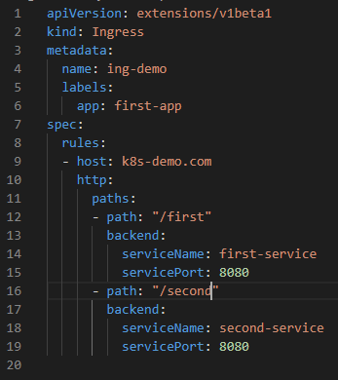
INGRESS Manifest
Host and protocol
Paths and backend services

Slide 35

HELM
Helm is an open source package manager for Kubernetes.
Provides the ability to provide, share, and use software built for Kubernetes
Charts are packages of pre-configured Kubernetes resources
You can use public charts or you can create private charts for your applications

Slide 36

Demo
Install nginx using HELM
Create ingress
Notes:
helm install nginx-demo nginx-stable/nginx-ingress –dry-run Mention why we are doing a dry run. Cause it is already installed
kubectl apply -f ingress-demo.yml
Delete the service deployment that was loadbalancer: kubectl delete -f service-demo.yml
Uncomment ClusterIP then redeploy kubectl delete -f service-demo.yml

Slide 37
More Resources Types
Volumes
Config Maps
Secrets
Stateful sets
Daemon sets
Jobs

Slide 38
Persistent Volumes
The process by which we can mount external volume with our pods during deployment.
Data will be safe even our pod become terminate or recreate.
Volumes can be mounted according to requirement with any required pods.
For communication, synchronization and caching emptyDir .
Notes:
An emptyDir volume is first created when a Pod is assigned to a Node, and exists as long as that Pod is running on that node. As the name says, it is initially empty. Containers in the Pod can all read and write the same files in the emptyDir volume

Slide 39
Persistent Volumes
Two main resources are required:
Persistent volume (PV)
Size of the total storage
Access mode of storage
IP address of storage if using external like SAN, NAS etc.
Which type of storage we are using like NFS, ISCSI etc.
Persistence volume claim (PVC)
During deployment, PVC claim space from PV that we target to assign to the new upcoming pod
Deployment
Persistent Volume Claim
Persistent Volume
Notes:
An emptyDir volume is first created when a Pod is assigned to a Node, and exists as long as that Pod is running on that node. As the name says, it is initially empty. Containers in the Pod can all read and write the same files in the emptyDir volume

Slide 40
Supported persistent Volumes
awsElasticBlockStore
azureDisk
azureFile
cephfs
cinder
configMap
csi
downwardAPI
emptyDir
fc (fibre channel)
flexVolume
flocker
gcePersistentDisk
gitRepo (deprecated)
glusterfs
hostPath
iscsi
local
nfs
persistentVolumeClaim
projected
portworxVolume
quobyte
rbd
scaleIO
secret
storageos
vsphereVolume
Notes:
There are many other types of volumes supported

Slide 41
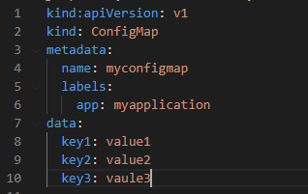
Config Maps
K8s object that holds configuration information using key/value approach
ConfigMap is combined with the Pod right before it is run.
The container image and the Pod definition itself can be reused across many apps by just changing the ConfigMap that is used.
Use cases:
Filesystem
Environment variable
Command-line argument
Notes:
You can mount a ConfigMap into a Pod. A file is created for each entry based on
the key name. The contents of that file are set to the value.
A ConfigMap can be used to dynamically set the value of an environment
variable.

Slide 42
Secrets
K8S native support to store “secrets”
Secrets enable container images to be created without bundling sensitive data. i.e. portability
By default, K8S secrets are stored in plain text in the etcd storage for the cluster. Depending on your requirements, this may not be sufficient security for you.
Recently, support has been added for encrypting the secrets with a user-supplied key, generally integrated into a cloud key store i.e. Azure Key value
Notes:
In particular, anyone who has
cluster administration rights in your cluster will be able to read all
of the secrets in the cluster. In recent versions of Kubernetes, sup‐
port has been added for encrypting the secrets with a user-supplied
key, generally integrated into a cloud key store. Additionally, most
cloud key stores have integration with Kubernetes flexible volumes,
enabling you to skip Kubernetes secrets entirely and rely exclu‐
sively on the cloud provider’s key store. All of these options should
provide you with sufficient tools to craft a security profile that suits
your needs.

Slide 43
Stateful sets
StatefulSets are replicated groups of Pods,
Similar to ReplicaSets. But unlike a ReplicaSet, they have certain unique properties:
Each replica gets a persistent hostname with a unique index
Each replica is created in order from lowest to highest index, and creation will block until the Pod at the previous index is healthy and available.
When a StatefulSet is deleted, each of the managed replica Pods is also deleted in order from highest to lowest.
Notes:
You can mount a ConfigMap into a Pod. A file is created for each entry based on
the key name. The contents of that file are set to the value.
A ConfigMap can be used to dynamically set the value of an environment
variable.

Slide 44
Daemon set
Used to schedule a single Pod on every node within the cluster.
Generally, the motivation for replicating a Pod to every node is to land some sort of agent or daemon on each node. i.e. log collectors and monitoring agents
A Daemon Set ensures a copy of a Pod is running across a set of nodes in a K8S cluster.
Notes:
You can mount a ConfigMap into a Pod. A file is created for each entry based on
the key name. The contents of that file are set to the value.
A ConfigMap can be used to dynamically set the value of an environment
variable.

Slide 45
Jobs
A job creates Pods that run until successful termination (i.e., exit with 0).
Jobs are useful for things you only want to do once, such as database migrations or batch jobs.
Notes:
You can mount a ConfigMap into a Pod. A file is created for each entry based on
the key name. The contents of that file are set to the value.
A ConfigMap can be used to dynamically set the value of an environment
variable.

Slide 46
Demo
Create ConfigMap
Use ConfigMap as environmental variable in Pod Manifest
Notes:
kubectl expose pod first-pod -n ns-demo --port 8080 --target-port 3000
Kubectl edit svc first-pod –n ns-demo

Slide 47
Role based-access control
RBAC
Authentication methods
Role and Role Binding
RBAC Manifests
Authorization verbs

Slide 48
RBAC
RBAC provides a mechanism for restricting both access to and actions on Kubernetes APIs to ensure that only appropriate users have access to APIs in the cluster.
RBAC is a critical component to both harden access to the Kubernetes cluster where you are deploying your application
RBAC prevent unexpected accidents where one person in the wrong namespace mistakenly takes down production when they think they are destroying their test cluster.
Notes:
Multitenant security in Kubernetes is a complex, multifaceted topic worthy of its own volume. While RBAC can be quite useful in lim‐ iting access to the Kubernetes API, it’s important to remember that anyone who can run arbitrary code inside the Kubernetes cluster can effectively obtain root privileges on the entire cluster. There are approaches that you can take to make such attacks harder and more expensive, and a correct RBAC setup is part of this defense. But if you are focused on hostile multitenant security, do not believe that RBAC by itself is sufficient to protect you. You must isolate the Pods running in your cluster to provide effective multitenant security. Generally this is done with a hypervisor isolated container, or some sort of container sandbox, or both.

Slide 49
Authentication methods
HTTP Basic Authentication
x509 client certificates
Static token files on the host
Cloud authentication providers like Azure Active Directory Identity and Access Management (IAM)
Authentication webhooks
Notes:
Illustrate Authentical VS authorization

Slide 50
Role and Role Binding
A role is a set of abstract capabilities. App Dev role might represent the ability to create Pods and services.
A role binding is an assignment of a role to one or more identities. binding the appdev role to the user identity Ala indicates that Ala has the ability to create Pods and services.
Role and Role Binding are 2 separate resources in K8S Role and RoleBinding
Roles and Role Binding can be applied on the cluster as a whole or a specific namespace ClusterRole, Role, ClusterRoleBinding, RoleBinding

Slide 51
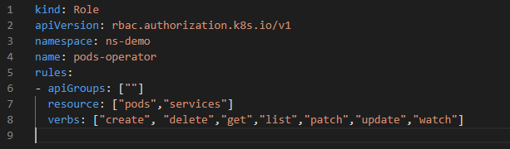
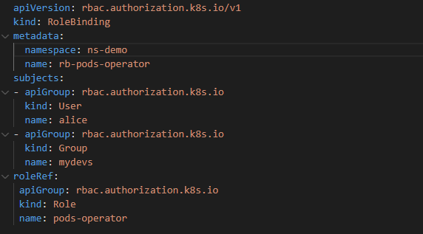
RBAC Manifests
The action the role can perform and on which resources
Role binding details.
Role to bind identities to.
Notes:
Multitenant security in Kubernetes is a complex, multifaceted topic worthy of its own volume. While RBAC can be quite useful in lim‐ iting access to the Kubernetes API, it’s important to remember that anyone who can run arbitrary code inside the Kubernetes cluster can effectively obtain root privileges on the entire cluster. There are approaches that you can take to make such attacks harder and more expensive, and a correct RBAC setup is part of this defense. But if you are focused on hostile multitenant security, do not believe that RBAC by itself is sufficient to protect you. You must isolate the Pods running in your cluster to provide effective multitenant security. Generally this is done with a hypervisor isolated container, or some sort of container sandbox, or both.

Slide 52
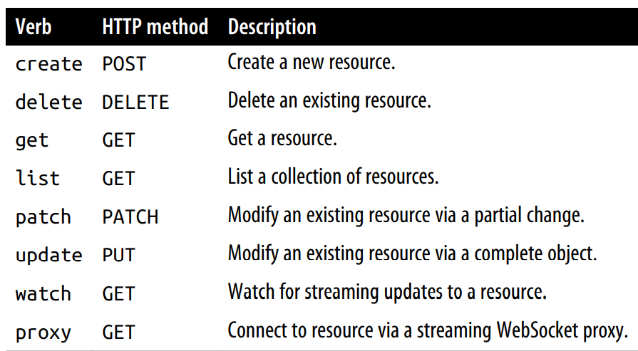
Authorization verbs
Notes:
You can mount a ConfigMap into a Pod. A file is created for each entry based on
the key name. The contents of that file are set to the value.
A ConfigMap can be used to dynamically set the value of an environment
variable.

Slide 53
Azure Kubernetes Service (AKS)
Why AKS?
Main features

Slide 54
Why AKS?
Simplifies the process of deploying a managed K8S cluster in Azure.
Reduces the complexity and operational overhead of managing Kubernetes by offloading much of that responsibility to Azure.
Azure handles critical tasks like health monitoring and maintenance for you.
The K8S masters are managed by Azure. You only manage and maintain the agent nodes.
AKS is free - you only pay for the agent nodes within your clusters, not for the masters.
Notes:
On prem and with multiple nodes it will be much more complicated

Slide 55
Main features
Identity and security management
Integrated logging and monitoring
Cluster node and pod scaling
Cluster node upgrades
GPU enabled nodes
Storage volume support
Ingress with HTTP application routing
Development tooling integration
Docker image support and private container registry
Regulatory compliance
Notes:
AKS supports Kubernetes role-based access control (RBAC). RBAC lets you control access to Kubernetes resources and namespaces, and permissions to those resources. You can also configure an AKS cluster to integrate with Azure Active Directory (AD). With Azure AD integration
To understand how your AKS cluster and deployed applications are performing, Azure Monitor for container health collects memory and processor metrics from containers, nodes, and controllers.
Kubernetes has a rich ecosystem of development and management tools such as Helm and the Kubernetes extension for Visual Studio Code. These tools work seamlessly with AKS. Additionally, Azure Dev Spaces provides a rapid, iterative Kubernetes development experience for teams. With minimal configuration, you can run and debug containers directly in AKS. To get started, see Azure Dev Spaces. The Azure DevOps project provides a simple solution for bringing existing code and Git repository into Azure. The DevOps project automatically creates Azure resources such as AKS, a release pipeline in Azure DevOps Services that includes a build pipeline for CI, sets up a release pipeline for CD, and then creates an Azure Application Insights resource for monitoring.

Slide 56
Demo
Create a cluster and attach a repository
Access cluster using kubectl
Apply a deployment
Load Balancer
IAM
Policies
Logging and monitoring
Cluster autoscaling and upgrade
Azure Kubernetes Services
Notes:
az login
az aks create --name aks-k8-azure --resource-group Kubernetes –attach-acr foody --generate-ssh-keys
az aks list -o table
az aks get-credentials --name foody --resource-group Kubernetes
kubectl config get-contexts
Create namespace first
Create deployment
Kubectl apply –f deployment-azure-demo.yml –n ns-demo
Kubectl get pods –n ns-demo –w
//comment cluster IP
//change IP to 80 so that load balancing does not get affected
//ensure the type is Load Balancer
kubectl apply -f .\service-demo.yml -n ns-demo
Look at the IP address

Slide 57
The End
Notes:
I work in CDD so I have to work in many initiatives……..

